Slide 1
Error Correction
in the circuit recognition domain
Notes:
Hi, I’m Eric Doi, and the problem I’ve been working on is error correction.

Slide 2
A sketch…
Notes:
So, suppose we draw a sketch. We can run it through the sketch recognizer, and

Slide 3
A possible recognition result
Notes:
…we might get something like this. It looks like the recognizer made a few mistakes:

Slide 4
Recognition is imperfect
Notes:
These wires here were included as part of this AND gate

Slide 5
Recognition is imperfect
Notes:
This NOT gate was NOT recognized as a gate

Slide 6
Recognition is imperfect
Notes:
And the recognizer has NO idea about these strokes over here.
So, how do we fix these errors?

Slide 7
Erase and redraw?
Notes:
Well, any drawing program should have an eraser, so maybe we can just erase the incorrectly recognized strokes and redraw them.

Slide 8
Erase and redraw?
Notes:
So, we erase.

Slide 9
Erase and redraw?
Notes:
We redraw. And maybe we can make it a little bit neater this time.
And then we cross our fingers and run it through the recognizer again.

Slide 10
Erase and redraw?
Notes:
But, maybe it STILL gets it wrong. We could repeat this process over and over, and we might never get it to recognize the circuit the way we want it to. And this would be very frustrating for the user, who would probably never use our program again.
So how can we make things better for the user? For one, we’d like to give the user the power to label the strokes exactly to prevent this situation. But we’d also like the correction process to be easier if possible.

Slide 11
Microsoft Handwriting Correction
Erase/rewrite
Word-level: Best-alternatives
Character-level: rewrite/alternatives
Altering
Notes:
For some inspiration, let’s consider the handwriting input interface used by Microsoft Vista. Besides erasing and rewriting, users can: make corrections on the word level by selecting from a list of next best alternatives; Or, they can change an individual letter by rewriting or choosing from alternatives.
So let’s take a look! *Open up pad, write handwriting very sloppily*
It thinks I wrote X. But maybe I meant to write… *choose from list*. And there it is. So word-level corrections are fast and easy to make because the interface lets me use the recognizer to build on top of my first attempt. This is more efficient than erasing and redrawing, where you have to discard your input and start over– maybe the result you wanted was going to be the recognizer’s next guess, and all it needed was a little bit of help. Or maybe not. Maybe what I wanted isn’t in the list… This is why it is useful to be able to correct individual characters. *correct individual letters*
(And if we still have problems, there IS a keyboard input method here that offers even more control. *Switch to keyboard* And there it is.)
*Switch back*
Now, there is one more method you could use, and that’s going back and altering your original input by adding new strokes. (Like this. *Do*) However, it’s hard to make it behave the way you want.
(but it shouldn’t be taken for granted; there’s a lot of things that have to be taken into account to make this effective (for example, the order and timing of strokes is often used as part of recognition, and the recognizer should understand that if strokes are spatially close but a few were added much later, they should still connect)
Shorter demo, more concise, 30 seconds

Slide 12
What about sketch?
Notes:
And now the question is, what about sketch? It’s a little different. For one, handwriting is pretty linear, but with sketching we have a 2-dimensional space. With handwriting, grouping is pretty straightforward; we have characters, and then those characters are grouped into words by whitespace. With sketches, it’s not as simple– we might not have such a natural way to indicate groups, and there might be multiple levels of grouping. Also, the domains are different. Handwriting is restricted to characters and words in the dictionary, but sketch domains can and will vary with every application.
(And this brings me to an important difference: with handwriting, once we figure out the text representation, we discard the input strokes. But in our case, we might want our sketch to double as its own visual representation.)

Slide 13
Sketch Correction Toolkit
Selecting and manually identifying
  A list of best guesses
Regrouping
Retracing
Notes:
With that in mind, what should we do? Like with the handwriting interface, we’d like a SET of tools to offer different levels of control.
First, we’d ALSO like to access the recognizer’s next best alternatives. Note that our circuit domain is limited, so we can actually have an exhaustive list of alternatives. That means we’ll have exact control.
Next, because grouping seems to be difficult with sketches, it might be helpful to have a tool that could indicate sets of strokes that should be interpreted together. (The recognizer could then attempt to re-analyze the sketch with the new grouping information.)
Finally, we’d also like our recognizer to be able to handle retracing or altering of the sketch, since it’s a natural way to make corrections.
Focus on user experience, preference
Illustrate tools
Show pictures for each one
Wrap up: Talk about current state of research

Slide 14
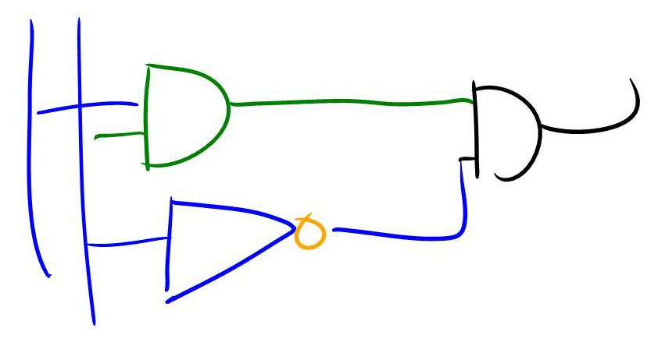
Alternates list
Notes:
So here’s how they would work. Let’s start by using the alternates list to fix those two wires

Slide 15
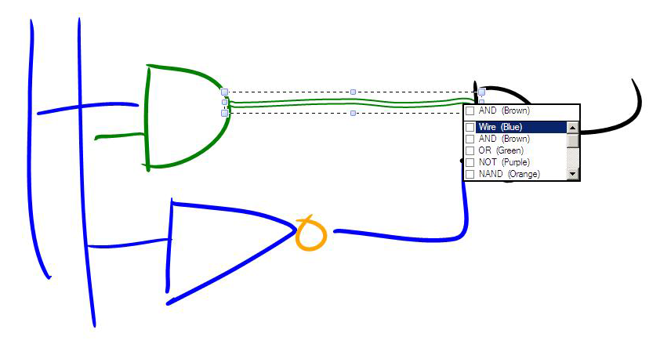
Alternates list
Notes:
So we’d select, and a menu with alternatives would pop up. We’d just choose wire

Slide 16
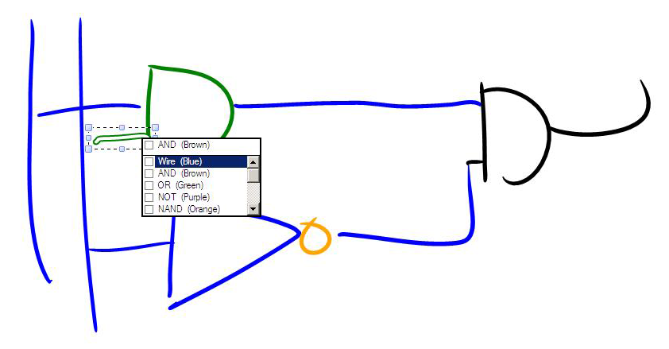
Alternates list
Notes:
And do the same for this other one

Slide 17
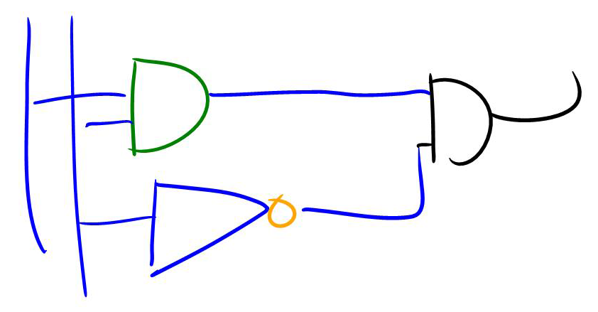
Alternates list
Notes:
And those are done

Slide 18
Regrouper
Notes:
Then let’s use the regrouper to fix that NOT gate

Slide 19
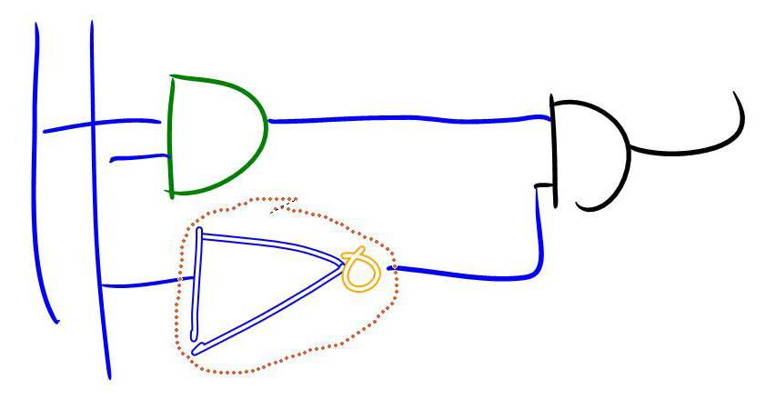
Regrouper
Notes:
We’d circle the entire gate

Slide 20
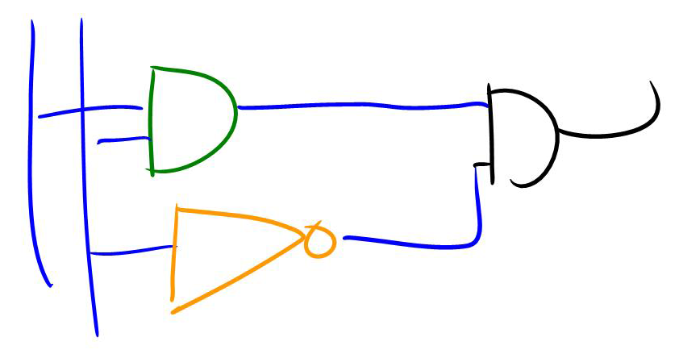
Regrouper
Notes:
And hopefully the recognizer would realize what it’s supposed to be and correct it.

Slide 21
Retracing
Notes:
And then retracing

Slide 22
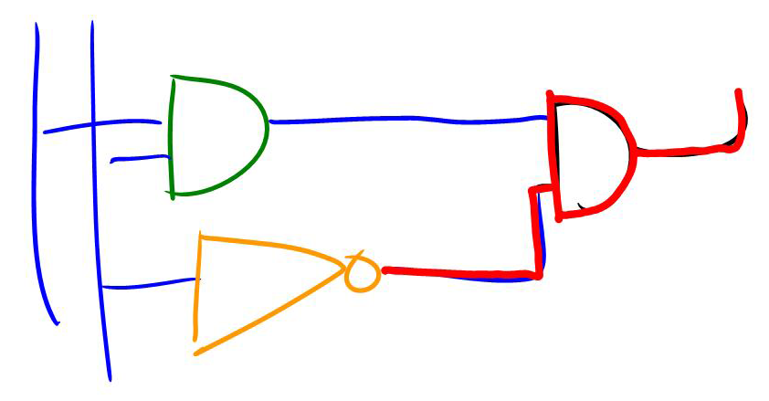
Retracing
Notes:
We’d draw on top of the sketch

Slide 23
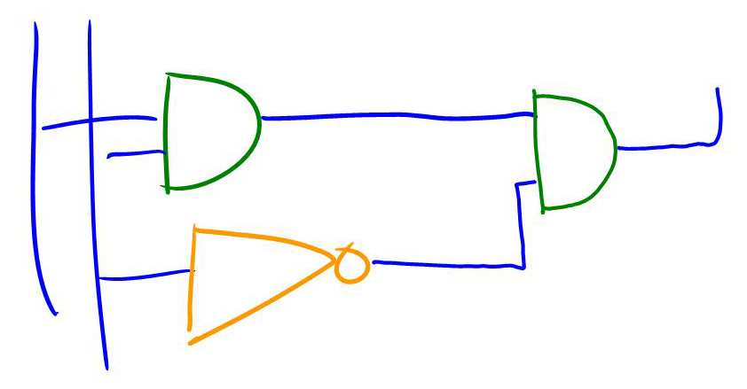
Retracing
Notes:
And it’d maybe do a better job this time. And if not, we’d use the alternates list to fix it.

Slide 24
Our current state
User studies
Simulation is difficult
Prepare for later integration
Notes:
So where are we now? Ultimately we’d like to do some user studies to see how the tools work in practice. At first we thought of simulating the tools, but this seemed increasingly difficult, so my goal now is to actually implement the tools for testing. Although the recognizer can’t interface fully with the tools right now, I will be making the toolkit in anticipation, so the recognizer can be hooked up to it as easily as possible when it is done.

